Slide 1
Welcome to
Newbie BootCamp
TravCon 2023

Slide 3
DISCLOSURES
No planner, presenter, faculty, author, or individual in a position to control content has identified a conflict of interest or relationship with an ineligible company that would affect this educational activity.
TravCon does not endorse any commercial products discussed or displayed in conjunction with this educational activity.
In order to obtain the contact hours for this activity, the learner must attend 100% of this educational activity, scan your badge, and complete the post activity evaluation form

Slide 6
TravCon has been approved to provide continuing education for the following professionals:
Nursing (ANCC Accredited Provider)
Physical Therapy (PT Board of CA Continuing Competency Approval Agency)
Occupational Therapy (AOTA Approved Provider, Activity # 05178)
Surgical Technology (CE Activity approved by AST)
Clinical Lab (CE Activity approved by PACE)
Radiology & Sonography (CE Activity approved by ASRT)
Respiratory Therapy (CE Activity approved by AARC)
Certificates of Attendance with contact hours will be
provided to all other professionals not listed above.
CONTINUING EDUCATION

Slide 8
Please scan your badge prior to each session attended and complete a post-conference evaluation.
Newbie BootCamp is considered 1 session so only one scan is needed today.
Most healthcare professionals are approved for 7 contact hours per day, however the total number of contact hours does vary for some professionals.
SCAN for CE Credit

Slide 10
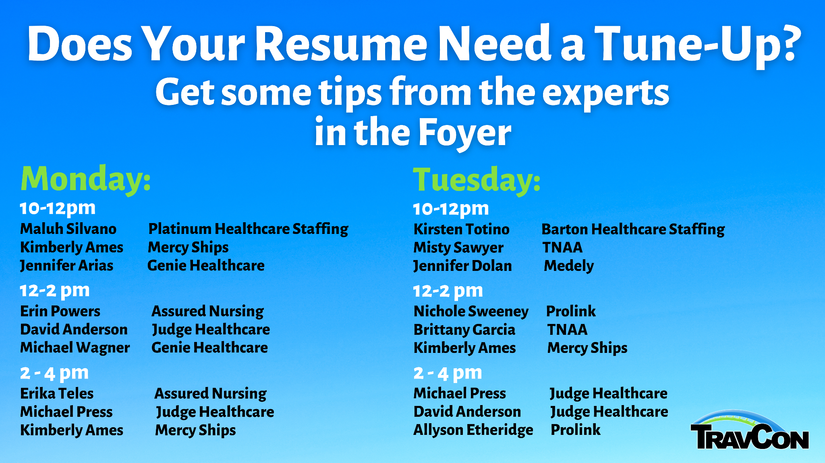

Slide 12
OBJECTIVES
After attending Newbie BootCamp learners will be able to:
Discuss best practices as it relates to finding a staffing agency/recruiter and interviewing for travel jobs
Understand the different components that make up a traveler pay package and how to negotiate traveler pay
Discuss best practices for being a successful traveler including skills related to managing conflict and acclimating to new work environments and cultures
Discuss certification and licensure standards, the uniform licensure requirements of compact licensure, and credentialing best practices

Slide 13
The TravCon App
Stay up to date on conference
updates with the TravCon App:
Scan the QR code on your badge
Choose your app store
Rescan QR code
Login: The email & password you registered with
Give feedback on sessions &
speakers to help us next year!

