Slide 1
Secrets to Finding the Right Travel Agencies
Speaker: Dylan Callier, DPT
Four year traveler, TravCon Committee Member,
Host of the New Medical Nomads Podcast

Slide 2
Objectives
At the completion of this session you will:
Know the primary differences between agencies
Know the roles and signs of a great recruiter
Know how to maintain a great relationship with your dream team of recruiters!

Slide 3
“The closer you come to knowing that you alone create your experience, the more vital it becomes for you to discover who is doing the creating.” - Eric Micha’el Leventhal
“Show me your friends and I’ll show you your future.” - Unknown
Create your own luck and assemble your dream team!
Notes:
“Show me your Agencies and I’ll show you your future!”

Slide 4
Choose Your Adventure!
Location --- (Setting) --- Pay --- Benefits
Notes:
Setting = Specialty Ask for 3 volunteers. Have them choose their #1 priority. 1 _____ is a young, healthy traveler without pre-existing medical conditions. She is self proclaimed “love em and leave em” type and has no partner. She goes wherever sounds the most exciting when she’s ready for the next contract. She hasn’t thought too much about retirement yet, and has been enjoying her extra cash with paying for experience, adventures, and trips to Costa Rica when not working. 2 _____ is an RV traveler that travels with her spouse and kid. Her partner homeschools their child, and with smart budgeting they have been able to travel and thrive on a single income. She is pretty healthy, and her spouse is (almost) the perfect patient and does well managing his Type-1 diabetes. Their kid is healthy, but since traveling they seem to need to go to urgent care every 6 months. 3 _____ started traveling because they heard it brings in more cash! They are frugal and weekly count their earnings while investing and has a goal of retiring by the age of 45 so they can move to Medellin, Colombia and enjoy the rest of their life with equator weather y una esposa

Slide 5
Agencies in General
How many are there?
How often do new agencies pop-up?
Is there really a big difference between agencies?
Notes:
How many are there?
How often do new agencies pop-up? Depends on the year, but when the market is up -- often!
Is there really a big difference between agencies? Yes! From leadership/culture, 80/20% of jobs, onboarding paperwork, benefits, etc

Slide 6
Benefits: Health Insurance
Do they offer health insurance?
Is it 1st Day? 30 Day? Or something weird?
My $1600 mistake!
If you take another contract, how long before your insurance “runs out?”
Last Day
30 days
Dental?
Notes:
Dental - most companies will have both

Slide 7
Benefits: Health Insurance Alternatives
Government
Marketplace / Insurance Sales Rep
COBRA
Health Shares - Might be a risk!
Notes:
Health Shares - Might be a risk!

Slide 8
Benefits: Other
401K
All over-the-place for rates, time needed to contribute,
and time needed to withdraw employer contributions
Clinical Liaison
Usually a 3rd party NP or experienced Nurse
Clinical Mentorship
Notes:
PLF and Clinical mentorship likely not a sole reason to choose a company

Slide 9
Benefits: Other #2
Housing Team
Becoming more rare
Partial Loan Forgiveness
Terms and conditions usually “lock” you into using only that company
Continuing Education
Notes:
All likely not a sole reason to choose a company

Slide 10
Agency Jobs
The 80/20
Location & setting
“Direct Marketing”
Notes:
Setting = government contracts, Home Health, Direct Access to big hospital systems

Slide 11
Agency Experience
Tech Influence
Customer Support

Slide 12
Agency Myths
Myth: “The bigger the company, the less the pay.” Myth: “I had payroll issues, they are a BAD company”
Myth: “They all have the same jobs anyways.”

Slide 13
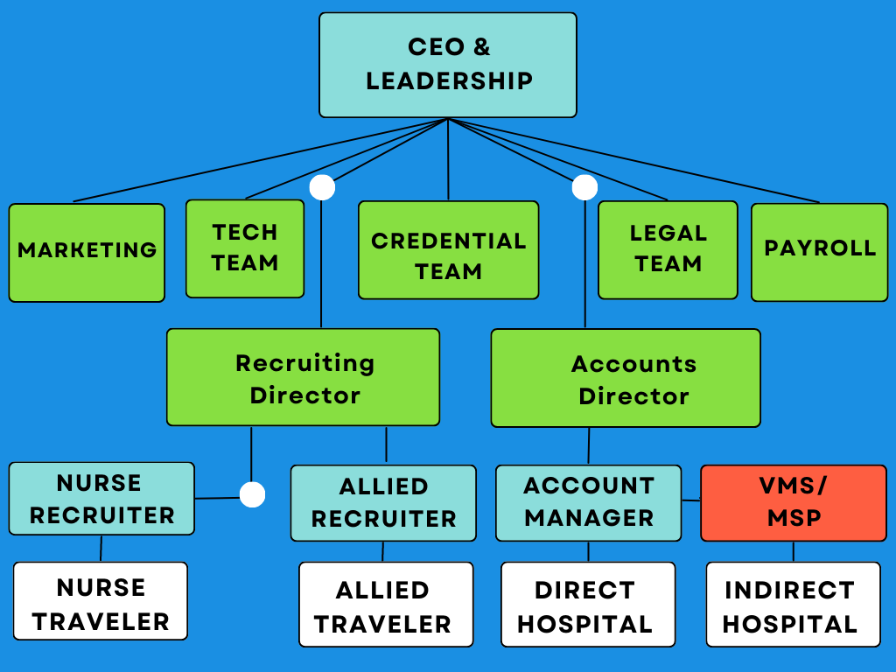
Typical
Agency
Anatomy

Slide 14
Recruiters - Your key player!
Likely the only company contact you will have
A coach, a lifeline, and customer service
An amazing recruiter can make an average company feel great and a below average recruiter can make a great company feel awful.

Slide 15
Recruiters: Their Role
Pre-Contract:
Contacting you and winning your trust
Notifying you of jobs/opportunities
Holding you accountable for all the onboarding
During:
Providing support if needed
Supporting plans for after this contract
Notes:
Mention roles after a contract when you are not working with them

Slide 16
Recruiters: What to ask? Agency Q’s
How long has your agency been staffing my profession?
What areas are your direct contracts? What types of jobs do you have?
Can you send your cert of insurance? What is your malpractice plan?
Do you have Day 1 Medical Insurance?
How do you pay Overtime/Extra Time/ Holiday Pay?
What are your cancelation terms? For both travelers and hospitals.
Can you send me the company’s benefits package?
Notes:
Looking for at least a 1 and 3 policy, 1 million for each case and up to 3 million aggregate Talk about these: What types of jobs do they have? (Specialty/Setting, General Locations, etc.) Do they have direct relationships or rely only on MSP providers? How do they pay overtime or extratime? Do they have day one medical insurance? How much time is allowed between contracts to maintain medical insurance coverage? How much will insurance cost you? (average is between $30 - $60 per week) Do they have medical malpractice insurance? 401K options: when can you start contributing and do they match? What does onboarding look like and what should you expect before accepting a job?

Slide 17
Recruiters: What to ask? Recruiter Q’s
How long have you been a recruiter?
How often do you contact travelers on assignment?
How often to you contact travelers when pursuing new jobs?
I work with multiple recruiters. Is that ok with you?
Do you blind submit travelers?

Slide 18
Recruiter Red Flags
Submitting you to travel assignments without your explicit approval.
Not showing you the full pay package before submitting you to a job.
Not putting promises in writing.
If they go MIA or "ghost."
Making you feel guilty for working with multiple recruiters and companies.
Notes:
These are in the booklet!

Slide 19
The Recruiter - Traveler Relationship
A great team strongly influences your success as a traveler
It is a professional partnership
Both are working with others - what is a full desk?
Notes:
You want to be #1 on that list! Talk about personalities on this slide - different negotiating types. Episode 90! Talk about the types of feelings you want from a recruiter - want to feel they are there when you need them, want to feel they have your best interest

Slide 20
How to be a Great Traveler
Great Travelers get to work with Great Recruiters!
Paperwork
Quick Communication
Have appropriate expectations about your market
Be clear about needs and wants
There’s a difference!
Notes:
“I need to be near this city because my spouse is there. I want to be within an hour’s drive, but I could be up to 3 hours.”
“I need medical insurance. I want to make this much so I can pay off my car.”

Slide 21
How to be a Bad Traveler
Below Avg Travelers get to work c/ Below Avg Recruiters
Be a Shark
Play “Sleaze Ball”
Be needy
Accept an interview and decline because of bad pay
Canceling a contract for unprofessional reasons
Notes:
Needy examples - constant reminders, difficult to please, ghosting
Most cancelations are by travelers! This is serious and even for a true emergency may receive a fine/fee/ or be unable to work with that company and parent/sister companies Accepting an interview is important - Story of recruiter calling late around Thanksgiving to get an interview and a job, submitting one traveler.
“I need medical insurance. I want to make this much so I can pay off my car.”

Slide 22
Alas, all things must come to an end...
When ending a relationship, be professional
Give the reason why so there are no questions and/or both sides can learn!
If wishing to work with another recruiter, politely ask.
If wishing to be taken off the company’s reach out list, ask this to be done, politely but firm.
Notes:
Can communicate this via phone call or email Needy examples - constant reminders, difficult to please, ghosting Accepting an interview is important - Story of recruiter calling late around Thanksgiving to get an interview and a job, submitting one traveler.
“I need medical insurance. I want to make this much so I can pay off my car.”

Slide 23
Big Takeaways
Have clear goals so you can choose your best team.
The best travelers are fast & great communicators!
Working with multiple recruiters is not only normal, it is expected. Work with 3.
Find a team that meets your appropriate expectations, then treat them like invaluable, professional partners
Notes:
How many recruiters is too many? Whenever your communication starts to be impacted.

